Slide 1
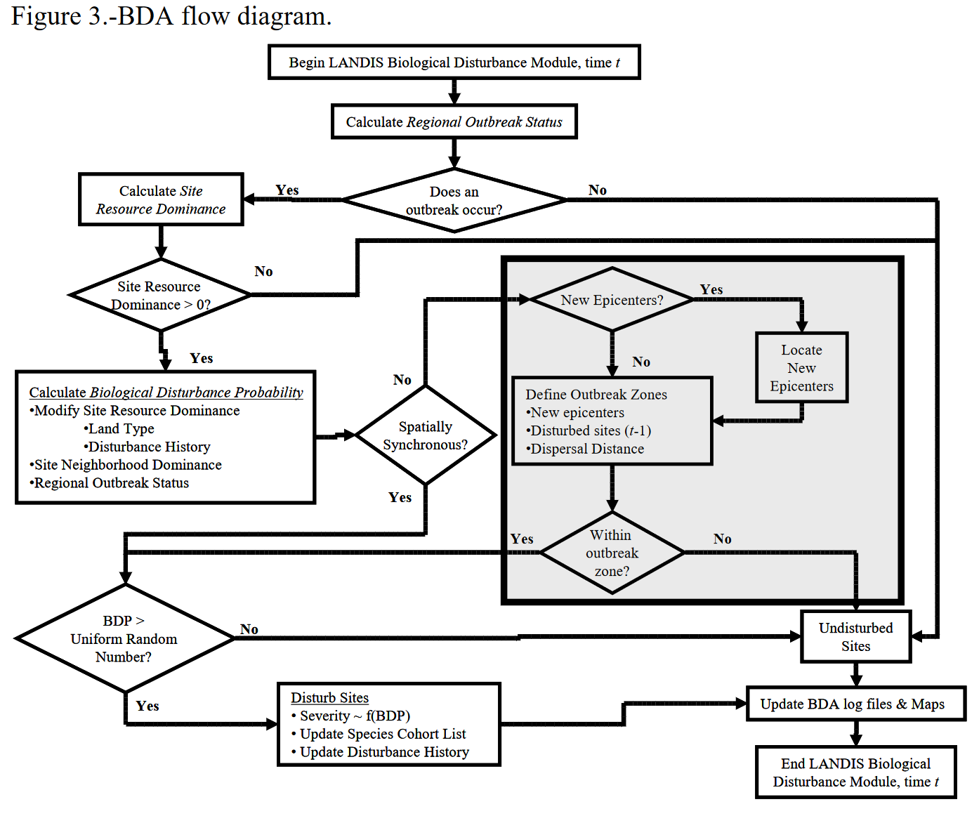

Slide 2
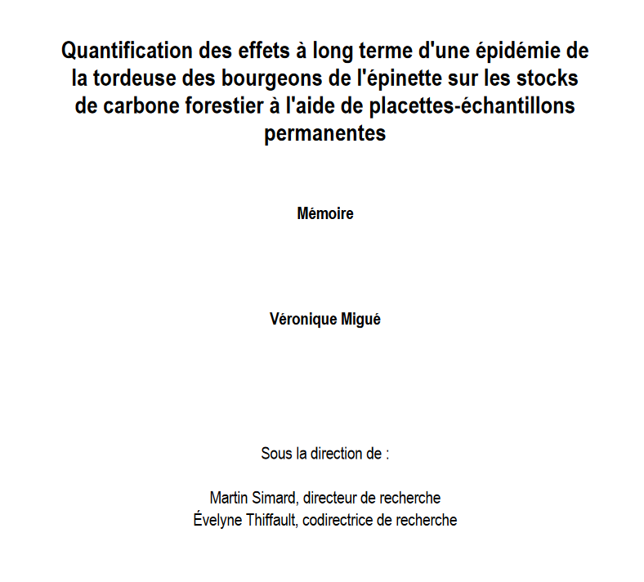

Slide 3
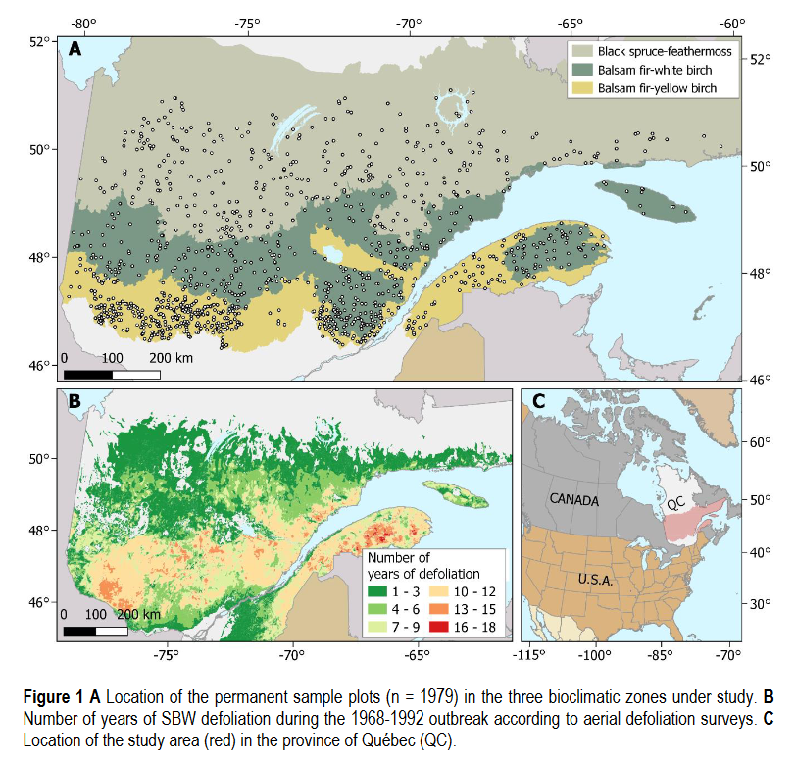
to be located in one of the three bioclimatic zones under study;
to have been measured at least twice, including once before or at the very beginning of the outbreak (0–2 years);
to have been free of any other significant disturbance (logging, fire, outbreak of another insect, etc.); and
to have been affected by SBW between 1968 and 1992 according to aerial defoliation surveys. The number of plots meeting these criteria was 2570.

Slide 4
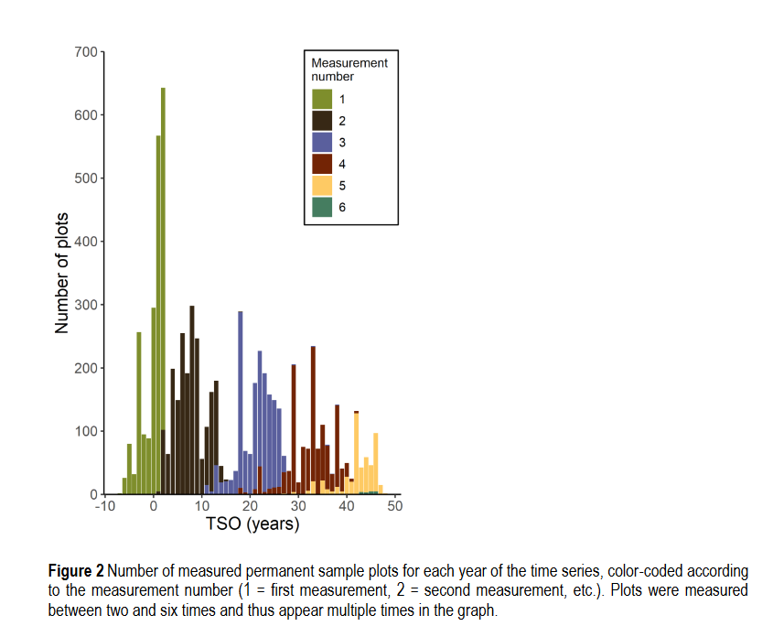
to be located in one of the three bioclimatic zones under study;
to have been measured at least twice, including once before or at the very beginning of the outbreak (0–2 years);
to have been free of any other significant disturbance (logging, fire, outbreak of another insect, etc.); and
to have been affected by SBW between 1968 and 1992 according to aerial defoliation surveys. The number of plots meeting these criteria was 2570.

Slide 5
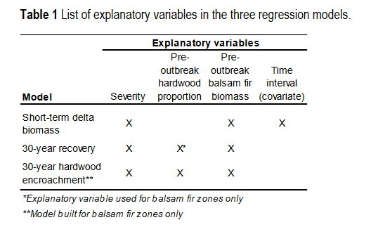

Slide 6
